Slide 1
ASPE Student challenge mounting provisions for the Z axis scribing head
Mark Kosmowski

Slide 2
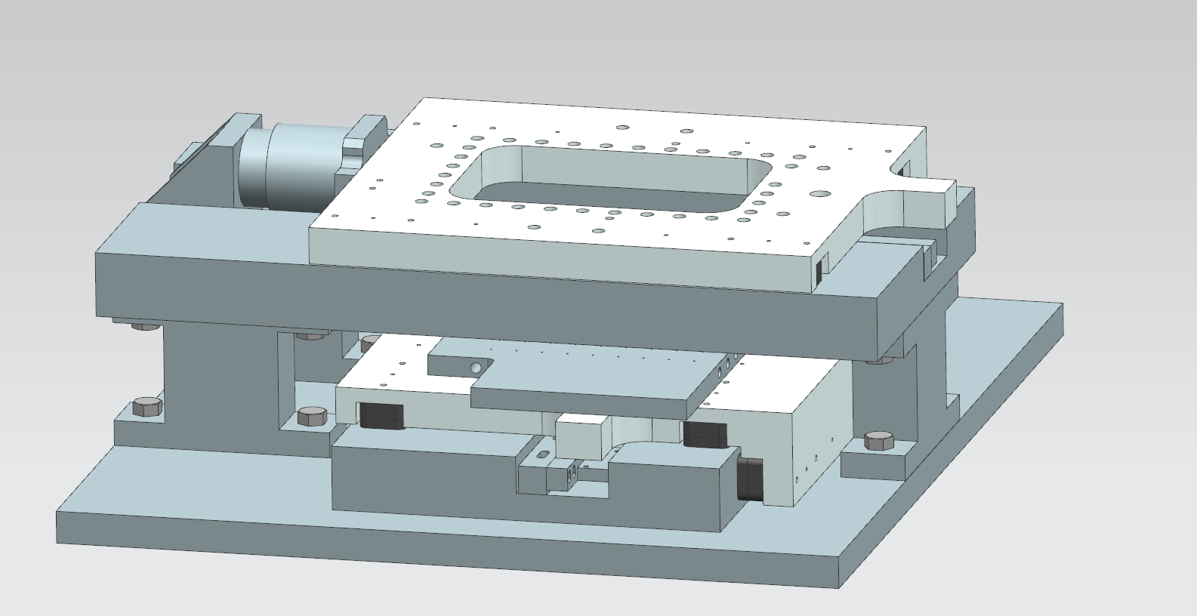
Overview of the stage that will be used in the second phase of the student challenge
The Z axis scribing head will be mounted on this surface

Slide 3
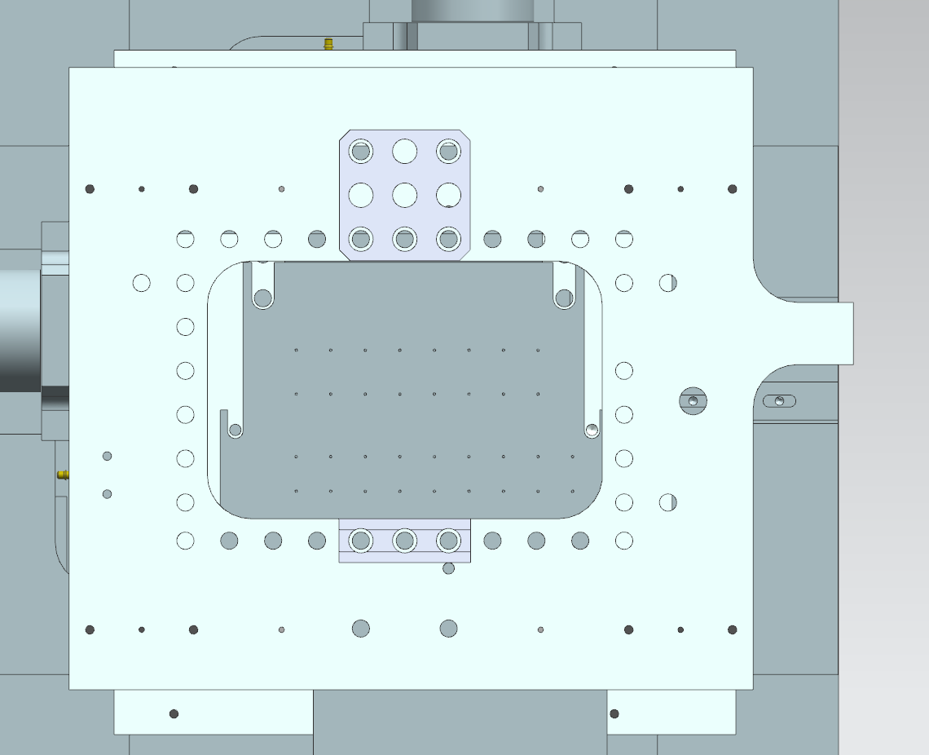
The hole pattern on the carriage is identical to the hole pattern on the Mech-blocks (0.500 inch or 12.70mm) the threaded holes are M6x1.0
Example of Mech blocks hole pitch compared to the hole pitch on the carriage. Build your z axis scribe head to fit on this stage

Slide 4
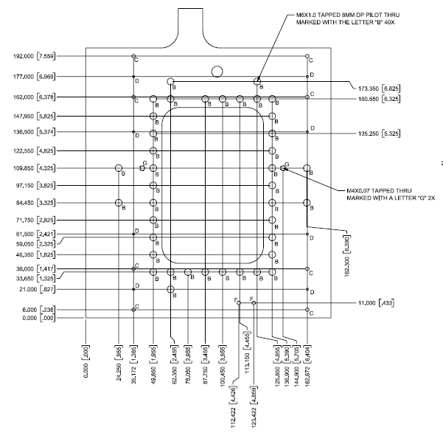
Detailed drawing of the top carriage plate were the Z-axis scribe head will be mounted. This drawing will be provided to each team in PDF form

Slide 5
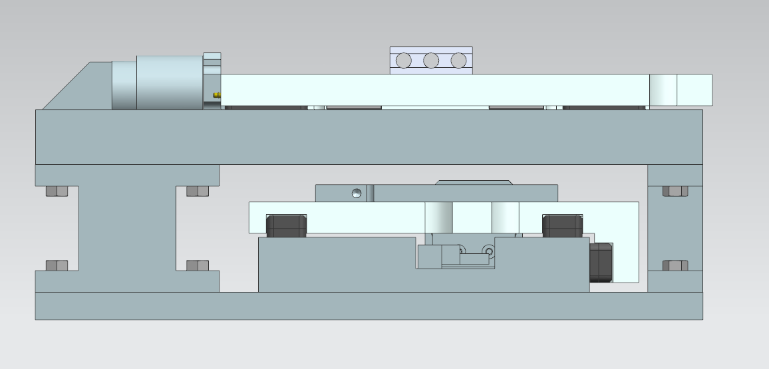
51 mm
Make a temporary structure to support your Z axis Scribing head, that emulates this height dimension. it can be made from Mech blocks or from other materials

Slide 6
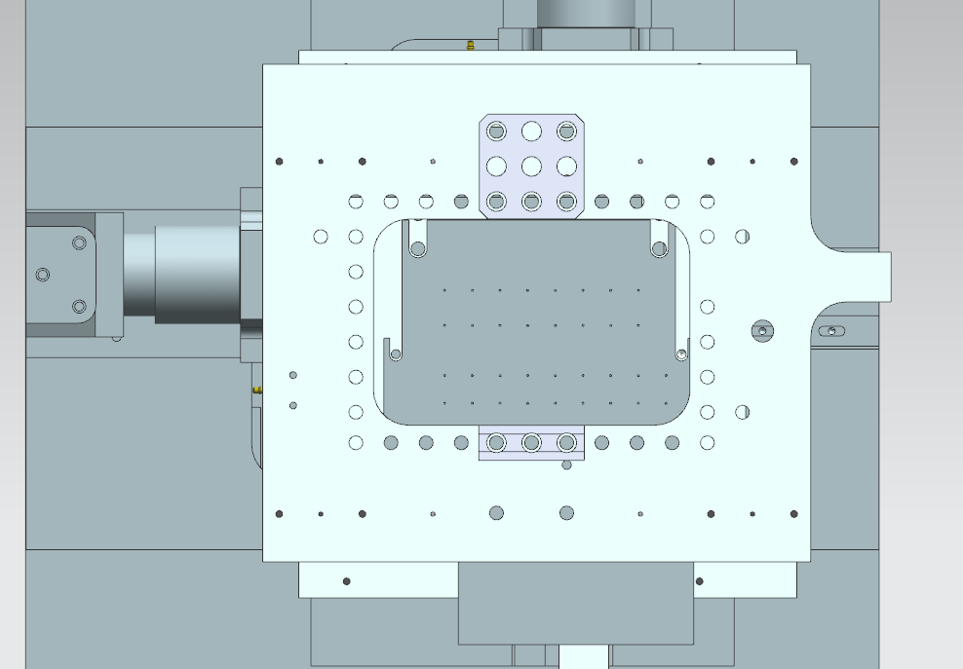
74.55 mm
Make a temporary structure to support your Z axis Scribing head, that emulates these dimensions. it can be made from Mech blocks or from other materials
114.3 mm

